Slide 1
Basics of Quantum Chromodynamics
(Two lectures)
Faisal Akram
5th School on LHC Physics, 15-26 August 2016
NCP Islamabad
2015

Slide 2
Outlines
A brief introduction of QCD
Classical QCD Lagrangian
Quantization
Green functions of QCD and SDE’s
Perturbative QCD
Perturbative calculation of QCD Green functions
Feynman Rules of QCD
Renormalization
Running of QCD coupling (Asymptotic freedom)
Non-Perturbative QCD
Confinement
QCD phase transition
Dynamical breaking of chiral symmetry

Slide 3





Elementary Particle Physics Today
Elementary particles:
Quarks Leptons Gauge Bosons Higgs Boson
(can interact through (cannot interact through (mediate interactions) (impart mass to the elementary
strong interaction) strong interaction) particles)
$\left(\begin{matrix} u \\ d\end{matrix}\right) \left(\begin{matrix} c \\ s\end{matrix}\right)$ $\left(\begin{matrix} t \\ b\end{matrix}\right)$
Hadrons:
Meson: $s=0,1,2…$
Baryons: $s=\frac{1}{2},\frac{3}{2},…$
Quarks:
$\left(\begin{matrix}v_{e} \\ e\end{matrix}\right) \left(\begin{matrix}v_{μ} \\ μ\end{matrix}\right)$ $\left(\begin{matrix}v_{τ} \\ τ\end{matrix}\right)$
Meson:
Baryon
Leptons:
Gauge Bosons:
$γ, W^{±}, Z^{0},$ and 8 gluons
399 Mesons, 574 Baryons have been discovered
Higgs Bosons:
$H$ (God/Mother particle)
Strong interaction (Quantum Chromodynamics)
Electro-weak interaction (Quantum electro-flavor dynamics)
The Standard Model
Explaining the properties of the Hadrons in terms of QCD’s fundamental degrees
of freedom is the Problem laying at the forefront of Hadronic physics.

Slide 4

How these elementary particles and the SM is discovered?
Scattering Experiments
Decay Processes
Study of bound states
Cross sections, Decay Constants,
Masses, Spin , Couplings, Form factors, etc.
Models
Particle Accelerators and detectors
Models
Experimental
Particle Physicist
Particle Physics
Phenomenologist
Theoretical Particle
Physicist
Measured values of
physical observables
$$≈$$
Calculated values of
physical observables
It doesn’t matter how beautifull your theory is,
It doesn’t matter how smart you are. If it doesn’t
agree with experiment, it’s wrong… R.P. Feynmann
It is more important to have beauty
in one's equations than to have
them fit experiment..... P.A.M Dirac
Decades of observation and calculations show that the Standard Model of particle physics
can describe almost every thing which we have observed in the labs of high energy physics.

Slide 5

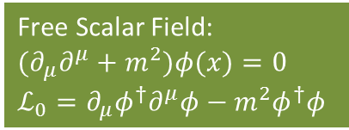

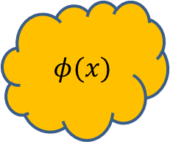

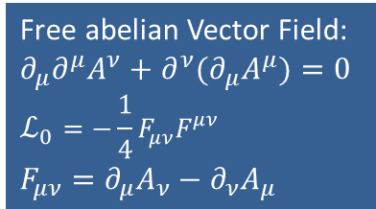

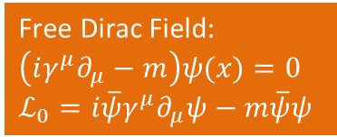
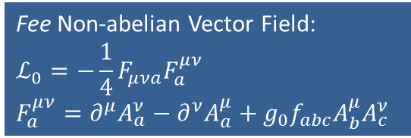
A Quick review of QFT’s
The standard model is a quantum field theory.
In field theories, fields (defined by field functions) act as fundamental dof of the system.
To every different kind of a particle we associate a field.
(e.g., electron field, proton field, photon field etc)
Particles appear as quanta of field.
$$φ(x)$$
Quantization
Quanta of field has particle properties.
Equation of motion of the fields
($s=0)$
($s=1)$
($s=1)$
Free Scalar Field:
$${(∂}_{μ}∂^{μ}+m^{2})φ(x)=0$$
$$ℒ_{0}=∂_{μ}φ^{†}∂^{μ}φ−m^{2}φ^{†}φ$$
Free abelian Vector Field:
$$∂_{μ}∂^{μ}A^{ν}+∂^{ν}{(∂}_{μ}A^{μ})=0$$
$$ℒ_{0}=−\frac{1}{4}F_{μν}F^{μν}$$
$$F_{μν}=∂_{μ}A_{ν}−∂_{ν}A_{μ}$$
Fee Non-abelian Vector Field:
$$ℒ_{0}=−\frac{1}{4}F_{μνa}F_{a}^{μν}$$
$$F_{a}^{μν}=∂^{μ}A_{a}^{ν}−∂^{ν}A_{a}^{μ}+g_{0}f_{abc}A_{b}^{μ}A_{c}^{ν}$$
($s=1/2)$
Free Dirac Field:
$$\left(iγ^{μ}∂_{μ}−m\right)ψ(x)=0$$
$$ℒ_{0}=i\overline{ψ}γ^{μ}∂_{μ}ψ−m\overline{ψ}ψ$$

Slide 6

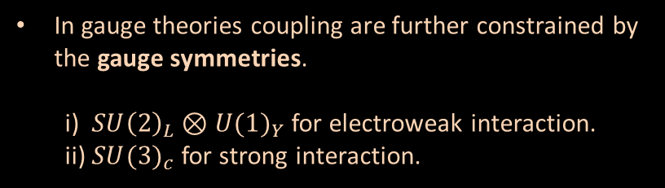

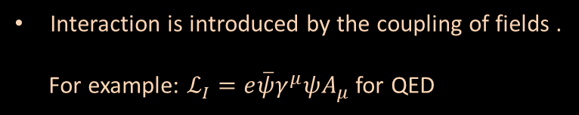


A Quick review of QFT’s
Interaction is introduced by the coupling of fields .
For example: $ℒ_{I}=e\overline{ψ}γ^{μ}ψA_{μ}$ for QED
$$\overline{ψ}$$
$$γ$$
$$ψ$$
Only Lorentz invariant couplings are allowed.
$ℒ_{I}=\overline{ψ}γ^{μ}ψA_{μ}$; $\overline{ψ}γ^{μ}γ^{5}ψA_{μ}$; $\overline{ψ}ψφ$; $\overline{ψ}γ^{5}ψφ$; $\overline{ψ}γ^{μ}ψ\overline{ψ}γ_{μ}ψ;$ . . . .
In gauge theories coupling are further constrained by the gauge symmetries.
i) ${SU\left(2\right)}_{L}⊗{U(1)}_{Y}$ for electroweak interaction.
ii) ${SU(3)}_{c}$ for strong interaction.

Slide 7








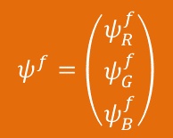


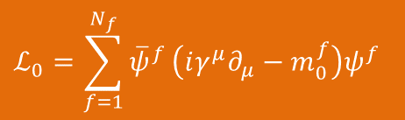
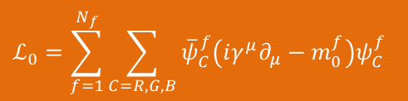
Quantum Chromo Dynamics (QCD)
(Foundations)
QCD is the theory of strong interaction of quarks, which is based on SU(3)_{c} color symmetry.
It assumes each flavor of quark comes in three different colors.
The color states of quarks are SU(3) triplets.
$$q$$
$$q$$
$$q$$
Quark Fields: $ψ_{C}^{f}$
$$f=1,2,3…N_{f}$$
$$C=R, G,B$$
$$N_{f}=6$$
$$R$$
$$G$$
$$B$$
Free Lagrangian of the Quarks:
$$ℒ_{0}=\sum_{f=1}^{N_{f}}{\sum_{C=R,G,B}{{\overline{ψ}}_{C}^{f}\left(iγ^{μ}∂_{μ}−m_{0}^{f}\right)ψ_{C}^{f}}}$$
The color states of quarks are SU(3)_{c} triplets.
$$ψ^{f}=\left(\begin{matrix}ψ_{R}^{f} \\ ψ_{G}^{f} \\ ψ_{B}^{f}\end{matrix}\right)$$
$$ℒ_{0}=\sum_{f=1}^{N_{f}}{{\overline{ψ}}^{f}}\left(iγ^{μ}∂_{μ}−m_{0}^{f}\right)ψ^{f}$$
Where$t^{a}$ are Gell-Mann matrices.
This Lagrangian is invariant under
global SU(3)_{c} gauge transformation.
Free and Classical QCD Lagrangian

Slide 8

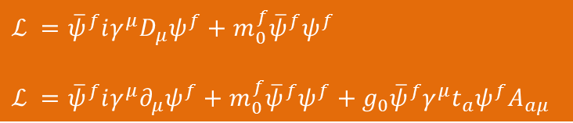
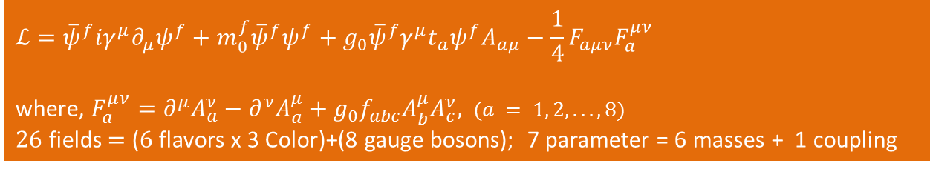
Quantum Chromo Dynamics (QCD)
(Foundations)
Extending the global gauge symmetry to local symmetry.
Local gauge transformation:
Global gauge transformation
Local gauge transformation
Free Lagrangian does not possess local symmetry:
$$ℒ_{0}={\overline{ψ}}^{f}iγ^{μ}∂_{μ}ψ^{f}+m_{0}^{f}{\overline{ψ}}^{f}ψ^{f}$$
Such that
$$ℒ ={\overline{ψ}}^{f}iγ^{μ}D_{μ}ψ^{f}+m_{0}^{f}{\overline{ψ}}^{f}ψ^{f}$$
$$ℒ ={\overline{ψ}}^{f}iγ^{μ}∂_{μ}ψ^{f}+m_{0}^{f}{\overline{ψ}}^{f}ψ^{f}+g_{0}{\overline{ψ}}^{f}γ^{μ}t_{a}ψ^{f}A_{aμ}$$
Including kinetic energy term of gauge fields
$$ℒ={\overline{ψ}}^{f}iγ^{μ}∂_{μ}ψ^{f}+m_{0}^{f}{\overline{ψ}}^{f}ψ^{f}+g_{0}{\overline{ψ}}^{f}γ^{μ}t_{a}ψ^{f}A_{aμ}−\frac{1}{4}F_{aμν}F_{a}^{μν}$$
where, $F_{a}^{μν}=∂^{μ}A_{a}^{ν}−∂^{ν}A_{a}^{μ}+g_{0}f_{abc}A_{b}^{μ}A_{c}^{ν},$ $(a = 1, 2,. . .,8)$
$26$ fields $=$ ($6$ flavors x 3 Color)+(8 gauge bosons); 7 parameter = 6 masses + 1 coupling
This complete Lagrangian is invariant under local SU(3)_{c} gauge transformation.

Slide 9
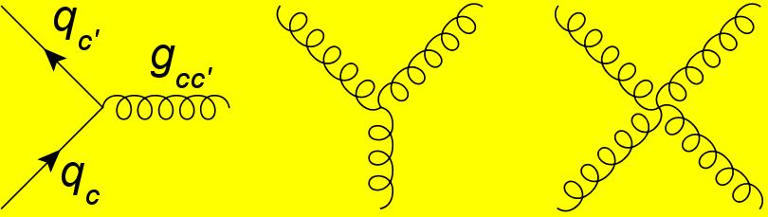
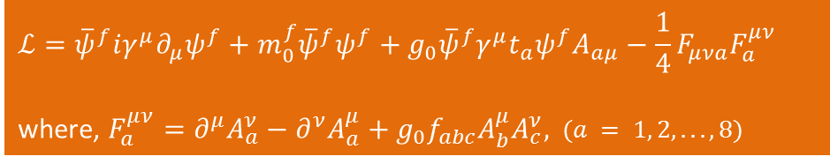
Quantum Chromo Dynamics (QCD)
(Foundations)
Interacting Classical QCD Lagrangian:
$$ℒ={\overline{ψ}}^{f}iγ^{μ}∂_{μ}ψ^{f}+m_{0}^{f}{\overline{ψ}}^{f}ψ^{f}+g_{0}{\overline{ψ}}^{f}γ^{μ}t_{a}ψ^{f}A_{aμ}−\frac{1}{4}F_{μνa}F_{a}^{μν}$$
where, $F_{a}^{μν}=∂^{μ}A_{a}^{ν}−∂^{ν}A_{a}^{μ}+g_{0}f_{abc}A_{b}^{μ}A_{c}^{ν},$ $(a = 1, 2,. . .,8)$
Quark-gluon interaction
3-point gluon interaction
4-point gluon interaction

Slide 10
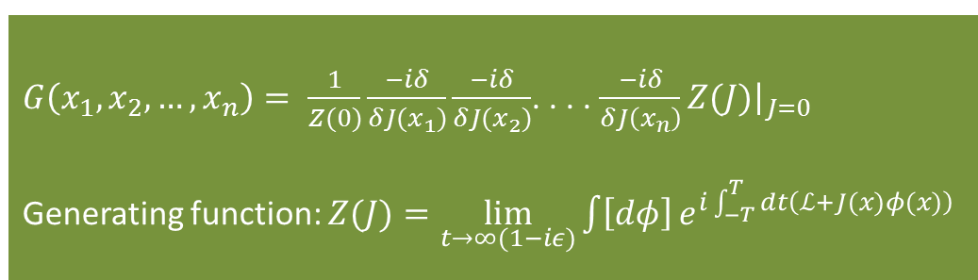
Quantum Chromo Dynamics (QCD)
(Quantization)
Green Functions of QFT
$$G\left(x_{1},x_{2},…,x_{n}\right)≡\left\langle Ω\left|T\left\{φ\left(x_{1}\right)φ\left(x_{2}\right)…φ\left(x_{n}\right)\right\}\right|Ω\right\rangle$$
$G\left(x_{1},x_{2},…,x_{n}\right)= \frac{1}{Z(0)}\frac{−iδ}{δJ(x_{1})}\frac{−iδ}{δJ(x_{2})}$. . . . $\frac{−iδ}{δJ\left(x_{n}\right)}{\left.Z(J)\right|}_{J=0}$
Generating function: $Z(J)=\lim_{t→∞(1−iε)}\int{\left[dφ\right]}{e^{i\int_{−T}^{T}{dt\left(ℒ+J(x)φ(x)\right)}}}$
Cross sections
Decay constants
Bound State masses
Couplings
Form factors
Generating function of QCD:
The path integration over gauge fields diverges due to
integrating over gauge equivalent configurations.
Fixing the gauge means choosing one configuration
out of gauge equivalent configurations.

Slide 11
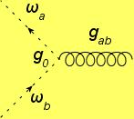
Quantum Chromo Dynamics (QCD)
(Quantization)
Gauge fixing implies
Not gauge invariant due
to gauge fixing.
The generating function Z must be gauge invariant because gauge transformation amounts to
redefine the variables integration.
This trivial requirement of Gauge invariance of the generating function translates into
non-trivial identities which all Green functions carrying gauge field(s) must satisfy.
QED:
Wards-Green-Takahashi identities (WGTI)
QCD:
Slavnov Taylor identities (STI)

Slide 12



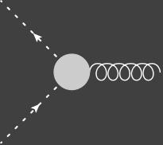
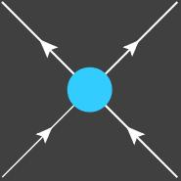
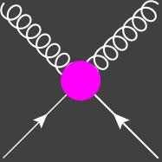

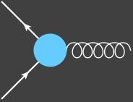
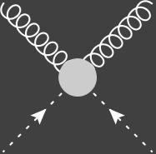
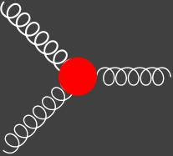



Green Functions of QCD
2-point Green functions:
$$\left\langle Ω | T\left\{ψ(x_{1}),\overline{ψ}(x_{2})\right\} | Ω\right\rangle ≡$$
$$\left\langle Ω | T\left\{ (A_{μ}^{a}(x_{1}),A_{υ}^{b}(x_{2})\right\} | Ω\right\rangle ≡$$
$$\left\langle Ω | T\left\{ (c_{}^{a}(x_{1}),c_{}^{b}(x_{2})\right\} | Ω\right\rangle ≡$$
3-Point Green functions:
4-Point Green functions:

Slide 13
Schwinger-Dyson Equations (SDEs) of QCD
In QFT the Green functions satisfy a set of exact mathematical equations called SDEs.
Corresponding to each green function we have a SDE.
These are exact equations and can be used to find Green functions perturbatively
as well as non-perturbatively.

Slide 14
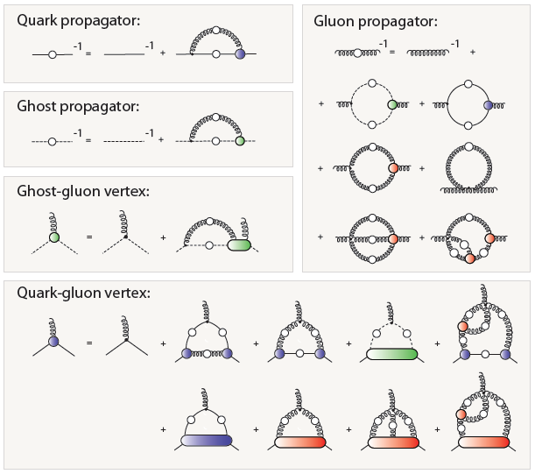

Slide 15
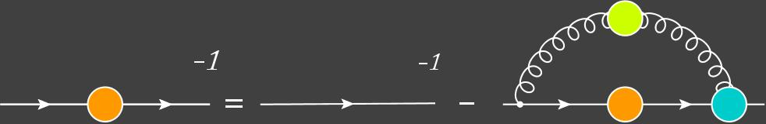
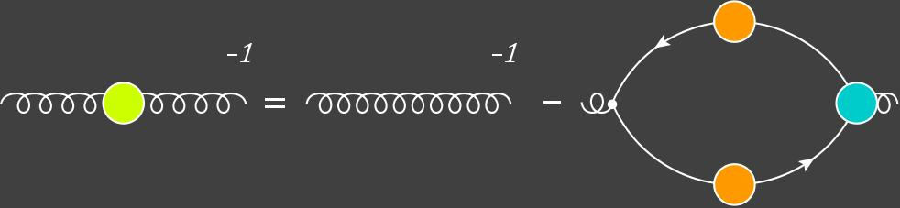
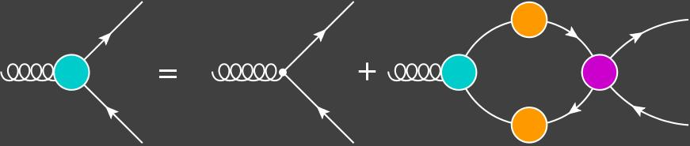

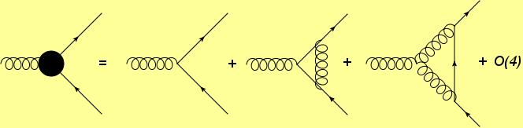

Schwinger-Dyson Equations of QCD
SDE of Quark Propagator:
Non Perturbative Truncation:
One or more Green functions are
modeled subjecting to some
general field theoretical constraints.
Or
Using the results obtained from lQCD.
SDE of Gluon Propagator:
+ 5 terms
SDE of quark-gluon vertex:
+ 7 terms
Perturbative Truncation:
$$N_{f}$$

Slide 16
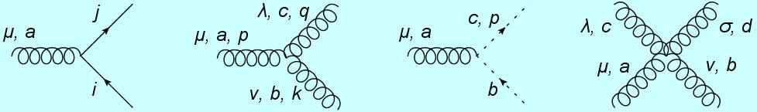
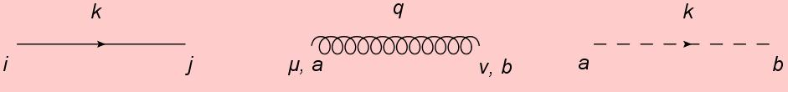
Feynman Rules of QCD
QCD full Lagrangian:
Where,
Vertices:
Propgators:

Slide 17




Color Algebra:

Slide 18
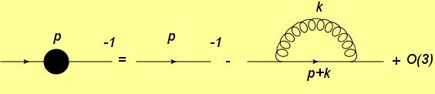
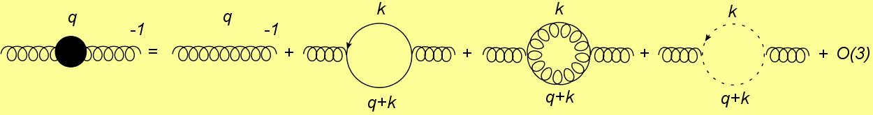



Leading order QCD green functions
Quark propagator:
$∝\int_{0}^{∞}{\frac{k^{3}dk}{k^{3}}}$ (Linearly divergent)
$$(k→∞)$$
Gluon propagator:
$∝\int_{0}^{∞}{k dk}$ (Quadratically divergent)

Slide 19


Quark gluon vertex (1PI):
$∝\int_{0}^{∞}{dk}/k$ (Logarithm divergent)
If theory is renormalizable then at any order of perturbation, all the divergences can be
absorbed by redefinitions of the coupling and fields.
Redefinitions of coupling and fields are made through multiplicative constants called
renormalization constants.
Gauge invariance which is expressed in terms of STI’s enforce that
i) All quarks are renormalized by same constant $Z_{F}$.
ii) All gluons are renormalized by same constant $Z_{B}$.
iii) All ghost are also renormalized by same constant $Z_{ω}$.

Slide 20
End of Lecture 1
Summery:
In QCD we have 5 different interactions
i) Quark-Gluon interaction
ii) 3 Gluon interaction
iii) 4 Gluon interaction
iv) Ghost-Gluon interaction
QCD green functions satisfy SDE’s which are exact but unsolvable unless truncated.
In perturbative truncation the amplitude of QCD green functions can be written
directly from the Feynman diagram using Feynman rules.
Naïve analysis show that these Green function carry ultraviolet divergences.
Since QCD in renormalizable, therefore, the divergences can be absorbed by redefinition
coupling and field of QCD.
Next Lecture:
We will continue renormalization program in QCD using dimensional regularization.
Discuss some non-perturbative aspects of QCD.

Slide 21
Procedure of Renormalization:
Regularize the field theory.
(i.e., to modify it temporarily in such way that all divergent integrals become finite)
i) Dimensional regularization
(breaks only scale invariance)
ii) Pauli-Villars regularization
(breaks Hermicity and gauge invariance in non-Abelian gauge theories)
iii) Lattice regularization
continuous space-time is replace by discrete Lattice of space-time.
Lattice spacing acts as regularizing parameter.
(breaks Poincaré invariance)

Slide 23
The $Π_{μν}^{gluon}$ and $Π_{μν}^{ghost}$ do not satisfy the condition of transversality.

Slide 25
Renormalization:
1. Multiplicative Renormalization Strategy:

Slide 26
2. Counter terms Strategy:

Slide 27
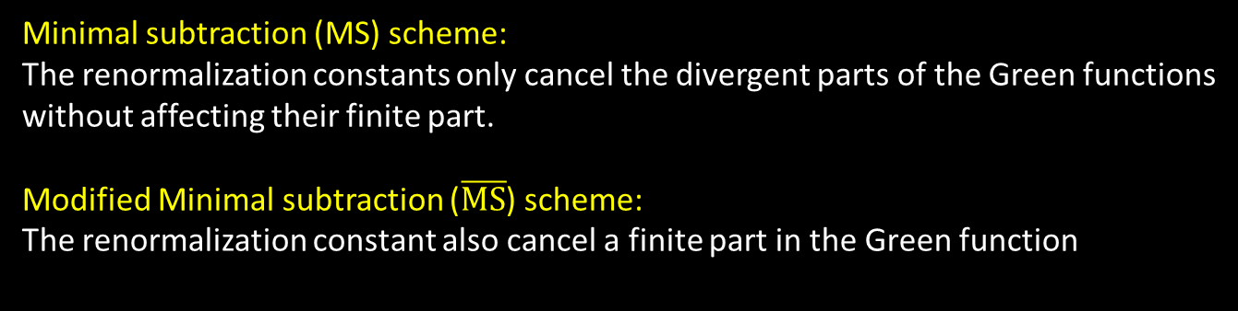
Renormalization Schemes:
A renormalization constant Z:
The divergent part is chosen in such a way that it cancels
the pole in un-renormalized Green function.
Each different way of choosing the finite part defines a
different renormalization scheme.
Minimal subtraction (MS) scheme:
The renormalization constants only cancel the divergent parts of the Green functions
without affecting their finite part.
Modified Minimal subtraction ($\overline{MS}$) scheme:
The renormalization constant also cancel a finite part in the Green function
These renormalization schemes are called mass independent renormalization schemes.
The results of perturbative calculations are scheme dependent.

Slide 28
Renormalization constants of QCD in $\overline{MS}$ at 1 loop order:
Renormalized gluon propagator
at 1 loop order:
Renormalized quark propagator
at 1 loop order:

Slide 29

Scale dependence in QCD:
Dimensional regularization necessitate the introduction of a scale parameter $ν_{0}$.
This dependence on $ν_{0}$ can easily be removed by redefining the renormalization
constants Z’s.
Renormalized green functions are now function of arbitrary scale parameter $ν$.
However, the physical observables must not depend upon the choice of $ν.$ This is ensured by
a correct $ν$ dependence of fundament constants (m’s and g’s) of the field theory.
$A\left(obs.\right)=A\left(m\left(ν\right), g\left(ν\right), gre. fun.\left(ν\right)\right)$

Slide 30
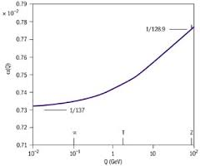
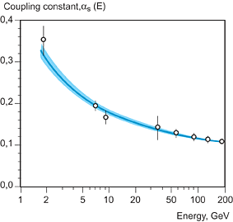

Running coupling of QED
The running of QCD coupling:
Taking the derivative w.r.t $log(ν)$.
QCD is asymptotically free

Slide 31
END of Lecture 1
Lecture 2 (non-perturbative QCD)

Slide 32
Quantum Chromodynamics
(Non-perturbative aspects)
Lecture 2
Faisal Akram
International Symposium on Physics Beyond the Standard Model
NCP Islamabad
2015

Slide 33
Outlines
Characteristics of QCD
Asymptotic freedom
Confinement
QCD phase transition
Dynamical breaking of chiral symmetry
Non-Perturbative truncation of Schwinger-Dyson equations
Models of quarks-gluon vertex and gluon propagator
Numerical Solution of SDE of quarks propagator
Results and comparison with the experiments

Slide 34

Characteristics of QCD
Asymptotic freedom
Quarks Confinement
QCD phase transition
Dynamical Breaking of Chiral Symmetry
$N_{f}<16.5$ (Asymptotic freedom)
* D. J Cross and F. Wilczek, PRL. 30, 1343 (1973); H. D. Politzer, PRL 30, 1346 (1973).

Slide 35
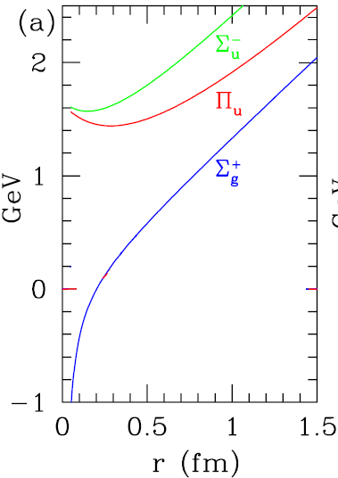

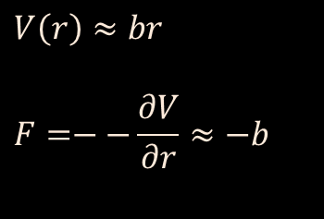
Characteristics of QCD
Asymptotic freedom
Quarks confinement
QCD phase transition
Dynamical Breaking of Chiral Symmetry
$$V\left(r\right)≈br$$
$$F=−−\frac{∂V}{∂r}≈−b$$
$$V(r)$$
* K.J. Juge, J. Kuti, and C. Morningstar, Phys. Rev. Lett. 90, 161601 (2003).

Slide 36
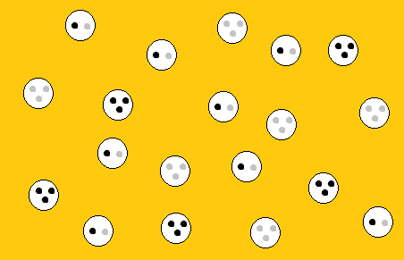
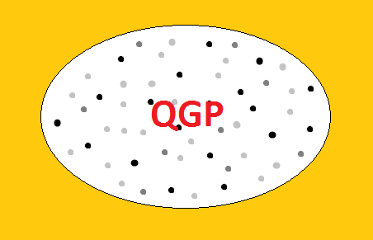
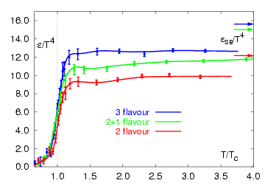
QCD phase transition
Confined State of Matter
De-Confined State of Matter
QGP is expected to produce at T_{c} ≈ 170 MeV ≈ 2 x 10¹² K ≈ 130,000 T☼ and  ≈ 0
Evidence of QGP?
Theoretical Evidence
So far no conclusive
experimental proof.

Slide 37
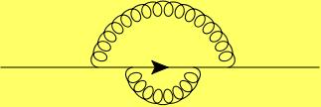



Quantum Chromo-dynamics
Asymptotic Freedom
Quarks confinement
QCD phase transition
Dynamical Breaking of Chiral Symmetry
(2008 Nobel Prize)
Current mass: $m_{u/d}=3−6$MeV
$M_{p}=939$ MeV
Self interaction of quarks
Constituent mass: $m_{u/d}≈350$MeV
 | u | d | s | c | b
Current mass (MeV) | 3 | 6 | 100 | 1100 | 4200
Constituent mass (MeV) | 350 | 350 | 530 | 1500 | 4600

Slide 38

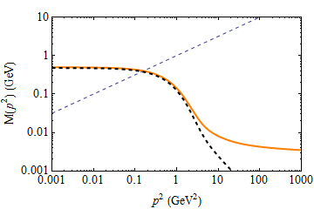



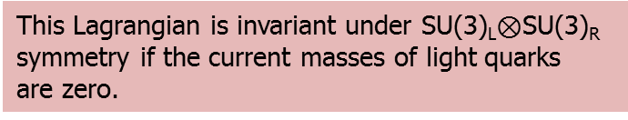

Dynamical Breaking of Chiral Symmetry in QCD
Fermionic part of QCD Lagrangian for light quarks:
This Lagrangian is invariant under SU(3)_{L}$⊗$SU(3)_{R}
symmetry if the current masses of light quarks
are zero.
Free quark propagator:
Pole mass
$m_{u/d}=3.7$MeV
Full propagator:
Mass function
(dynamical mass)
$$M\left(p^{2}\right)=\sqrt{p^{2}}$$
Pole mass,
$M_{u/d}=390$MeV
$m_{u/d}=3.7$MeV
Perturbative
expansion
If the current mass m = 0 then M(p²) = 0
Schwinger-Dyson equations (A non-perturbative technique)
Where, p² > Λ²_{QCD} =0.2 GeV
Renormalization point independent
Quark condensate
What if, p² < Λ²_{QCD}??
Non-zero value of M(p²) even when m = 0 means chiral symmetry
is dynamically broken.

Slide 39
Green Functions of QCD
2-point Green functions:
$$\left\langle Ω | T\left\{ψ(x_{1}),\overline{ψ}(x_{2})\right\} | Ω\right\rangle ≡$$
$$\left\langle Ω | T\left\{ (A_{μ}^{a}(x_{1}),A_{υ}^{b}(x_{2})\right\} | Ω\right\rangle ≡$$
$$\left\langle Ω | T\left\{ (c_{}^{a}(x_{1}),c_{}^{b}(x_{2})\right\} | Ω\right\rangle ≡$$
3-Point Green functions:
4-Point Green functions:

Slide 40


Schwinger-Dyson Equations of QCD
SDE of Quark Propagator:
SDE of Gluon Propagator:
$$N_{f}$$
+ 5 terms
SDE of quark-gluon vertex:
+ 7 terms
Perturbative Truncation:
Non Perturbative Truncation:
One or more green functions are
modeled subjecting to some
general field theoretical constraints.
Or
Using the results obtained from lQCD.
$$N_{f}$$

Slide 41




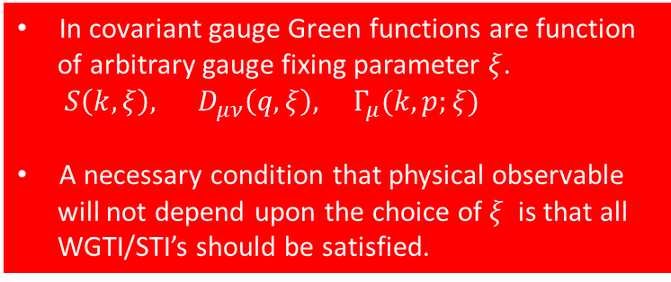



Green Functions of QCD (continued)
$$k$$
$$k$$
Quark Propagator:
Free Quark Propagator:
$$q$$
Gluon Propagator:
Free Gluon Propagator:
WGTI of gluon propagator implies $D^{L}\left(q^{2}\right)=ξ_{0}$
$$p$$
In covariant gauge Green functions are function
of arbitrary gauge fixing parameter $ξ$.
$S\left(k,ξ\right), D_{μν}\left(q,ξ\right), Γ_{μ}(k,p;ξ)$
A necessary condition that physical observable
will not depend upon the choice of $ξ$ is that all
WGTI/STI’s should be satisfied.
Quark-Gluon Vertex:
$$k$$
$${iq}_{μ}Γ_{μ}^{}=S^{−1}\left(k\right)−S^{−1}\left(p\right)$$
WGTI of quark gluon vertex

Slide 42
SDE of Quark Propagator:
To solve the SDE of quark propagator we require the knowledge
of full gluon propagator and quark-gluon vertex.
We model gluon propagator and quark-gluon vertex subjecting
to some general field theoretical constraints or using results from
lQCD.
What necessary and sufficient knowledge of
gluon propagator and quark-gluon vertex is
required in order to describe the complete
and correct behavior of quark propagator?
Field Theoretical Constraints:
Gauge Invariance (WGTI’s or STI’s).
Gauge covariant relations.
Multiplicative renormalizability.
Agreement with perturbation theory in weak coupling limit.
The model should also agree with lQCD in construction as well as in its implications.
Phenomenological agreement is an ultimate condition.

Slide 43
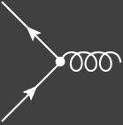


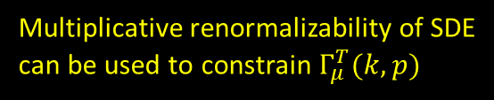

Models of Quark-gluon Vertex
Replacing by free vertex
Rainbow Truncation
This model breaks WGTI/STI of quark gluon vertex.
$${iq}_{μ}Γ_{μ}^{}=S^{−1}\left(k\right)−S^{−1}\left(p\right)$$
Constraint on the vertex due to WGTI:
$${iq}_{μ}Γ_{μ}^{L}=S^{−1}\left(k\right)−S^{−1}\left(p\right)$$
$$q_{μ}Γ_{μ}^{T}=0$$
Multiplicative renormalizability of SDE
can be used to constrain $Γ_{μ}^{T}(k,p)$
Longitudinal part is called Ball Chiu (BC) part.

Slide 44


Renormalization of SDE of quark propagator
SDE of Quark Propagator:
The MR requires that all Green functions should be
renormalizable by using finite number of multiplicative
renormalization constant.
The condition of MR cannot be satisfied by any arbitrary
quark-gluon vertex ansatz in SDEs.
How to do renormalization:
$$ψ=Z_{2}^{−1/2}ψ_{0}$$
$$A_{μ}^{a}=Z_{3}^{−1/2}A_{0μ}^{a}$$
$$g=\frac{Z_{2}Z_{3}^{1/2}}{Z_{1}}g_{0}$$
Regularize the theory by
applying hard momentum
cutoff.
Renormalized green functions are function of arbitrary scale parameter $μ$.
However, the physical observables must not depend upon the choice of $μ.$ This is ensured by
a correct $μ$ dependence of fundament constants (m’s and g’s) of the field theory.
$A\left(obs.\right)=A\left(m\left(μ\right), g\left(μ\right), gre. fun.\left(μ\right)\right)$

Slide 45

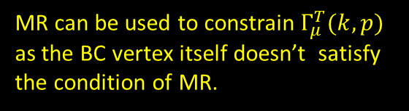


Multiplicative Renormalizability
The condition of MR cannot be satisfied by any arbitrary quark-gluon vertex ansatz in SDEs.
(An example)
Quark renormalization function in leading-logarithm approximation:
MR requires that $A_{2,2}=A_{1,1}^{2}/1!$
If we use bare approximation of quark-gluon vertex in quark propagator SDE we get
(where $M\left(p^{2}\right)$ is taken zero as an approximation)
MR can be used to constrain $Γ_{μ}^{T}(k,p)$
as the BC vertex itself doesn’t satisfy
the condition of MR.
In which $A_{2,2}=\frac{3}{2}A_{1,1}^{2}/1!$

Slide 46
Models of Quark Gluon Vertices
2. Curtis Pennington (CP) Vertex:
CP vertex satisfies the condition of MR in quench approximation for zero as well
as non-zero quark mass.
3. Kizilersu Pennington (KP) Vertex:
KP vertex satisfies the condition of MR in un-quenched approximation only for zero quark mass.

Slide 47
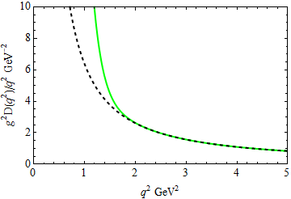

Models of gluon propagator
SDE of Quark Propagator:
Rainbow Truncation
Maris-Tandy Model: It is based on Rainbow truncation of vertex.
Gluon propagator:
(in Landau gauge)
(Perturbative calculation)
Maris-Tandy Model
Infrared dominant; A Model
UV dominant; Given by perturbative QCD
MT model
$ω=0.4$ so that the first term don’t perturb with 2nd in UV region.
$D=0.93$ GeV² is fitted to lQCD result of quark condensate ,
$−{\left\langle \overline{q}q\right\rangle }_{μ=1 GeV}={\left(0.241\right)}^{3}$GeV³.
Perturbative
This model does not include any N_{f} dependence in the infrared part.

Slide 48

Solution of SDE of quark propagator in Rainbow truncation + MT model
We need to first fix the renormalization constants Z₁ and Z₂.
$Z_{2}=Z_{1}$ (WGTI of quark-gluon vertex)
On-mass shell renormalization scheme.
Renormalization BC:
Renormalized current mass

Slide 49
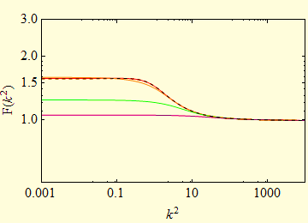
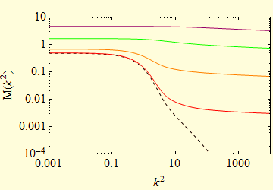
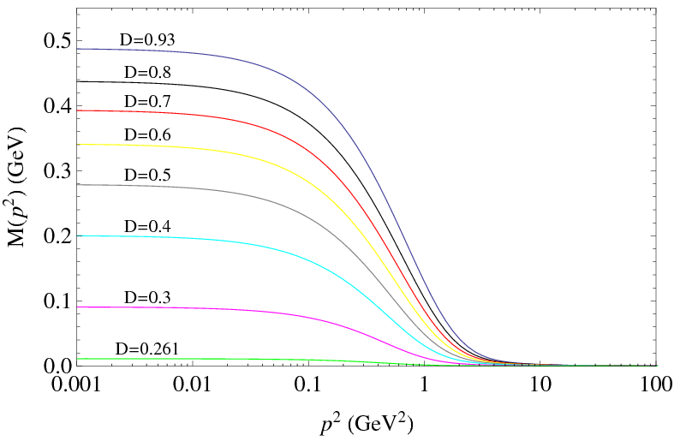


Quark Propagator using MT model
b
c
s
u/d
$m_{u/d}=0.00374$ GeV
$m_{s}=0.083$ GeV
$m_{c}=0.88$ GeV
$m_{b}=3.8$ GeV
How the model generates Dynamical mass?
$μ=19$ GeV
The 1st term of the MT model enhance
the coupling strength in IR region through
the controlling parameter D.
It is this enhancement which generates dynamical
mass in IR region.
Gradual decrease in parameter D shows that DCS is
restored if D < 0.261.
MT model of gluon propagator function:

Slide 50






Comparison with Qu-lQCD results:
Pion form factor
hBSE:
Ladder Truncation
MT model

Slide 51



Quark Mass functions using KP Vertex
Troubles with MT model:
Rainbow truncation breaks Gauge invariance
as the WGTI/STI of quark-gluon is not satisfied.
As a result physical observable may develop
dependence on gauge fixing parameter $ξ$.
Violates multiplicative renormalizability.
As a result physical observable may develop
dependence on arbitrary scale parameter $μ$.
$$Γ_{μ}(k,p)→γ_{μ}$$
Kizilersu Pennington (KP) Vertex:
KP vertex satisfies the condition of MR in un-quenched approximation

Slide 52




Critical number of quark flavors in QCD
Asymptotic freedom requires that N_{f} > 16.5 (at 1 loop order).
Dynamical breaking of chiral symmetry may also require a critical number of quark flavors.
SDE of Quark Propagator:
MT model does not allow as to study the flavor
dependence of quark propagator in the infrared
region as the gluon propagator is itself taken
Flavor independent.
Gluon propagator (in Landau gauge $ξ$=0):
$$N_{f}$$
+ 5 terms
Fit with Refined Gribov-Zwanziger (RGZ) form
A. Ayala, A. Bashir, D. Binosi M. Cristofretti, and J. Rodriguez-Quintro, Phys. Rev. D 86, 074512 (2012)

Slide 53

Solution of SDE of the Quark Propagator
SDE of Quark Propagator:
General form of quarks propagator:
Lattice QCD
KP Vertex
(Current mass $m=0$)

Slide 54

Final remarks
Asymptotic freedom in QCD requires that $N_{f}<16.5.$
Latest lattice results of gluon propagator when used in SDE of quark propagator
truncated by KP vertex shows that $N_{f}<7.2$ if QCD is to exhibit DCSB.

Slide 55
Extra slides

Slide 56
Elementary Particle Physics Today
Elementary particles:
Quarks Leptons Gauge Bosons Higgs Boson
(can interact through (cannot interact through (mediate interactions) (impart mass to the elementary
strong interaction) strong interaction) particles)
$\left(\begin{matrix} u \\ d\end{matrix}\right) \left(\begin{matrix} c \\ s\end{matrix}\right)$ $\left(\begin{matrix} t \\ b\end{matrix}\right)$
Hadrons:
Meson: $s=0,1,2…$
Baryons: $s=\frac{1}{2},\frac{3}{2},…$
Quarks:
$\left(\begin{matrix}v_{e} \\ e\end{matrix}\right) \left(\begin{matrix}v_{μ} \\ μ\end{matrix}\right)$ $\left(\begin{matrix}v_{τ} \\ τ\end{matrix}\right)$
Meson:
Baryon
Leptons:
Gauge Bosons:
$γ, W^{±}, Z^{0},$ and 8 gluons
399 Mesons, 574 Baryons have been discovered
Higgs Bosons:
$H$ (God/Mother particle)
Strong interaction (Quantum Chromodynamics)
Electro-weak interaction (Quantum electro-flavor dynamics)
The Standard Model
Explaining the properties of the Hadrons in terms of QCD’s fundamental degrees
of freedom is the Problem laying at the forefront of Hadronic physics.

Slide 57
Elementary Particle Physics
Scattering Experiments
Decay Processes
Study of bound states
Cross sections, Decay Constants,
Couplings, Form factors, Masses, Spin etc
Models
Particle Accelerators and detectors
Models
Experimental
Particle Physicist
Particle Physics
Phenomenologist
Theoretical Particle
Physicist
Measured values of
physical observables
$$≈$$
Calculated values of
physical observables
It doesn’t matter how beautifull your theory is,
It doesn’t matter how smart you are. If it doesn’t
agree with experiment, it’s wrong… R.P. Feynmann
It is more important to have beauty
in one's equations than to have
them fit experiment..... P.A.M Dirac
Decades of observation and calculations show that the Standard Model of particle physics
can describe almost every thing which we have observed in the labs of high energy physics.

Slide 58





The Standard Model
The standard model is a field theory.
In field theories we associate a field to every different kind of a particle.
(e.g., electron field, proton field, photon field etc)
Particles appear as quanta of field.
$$φ(x)$$
Quantization
Quanta of field has particle properties.
Equation of motion of the fields
($s=0)$
($s=1)$
Free Scalar Field:
$${(∂}_{μ}∂^{μ}+m^{2})φ(x)=0$$
$$ℒ_{0}=∂_{μ}φ^{†}∂^{μ}φ−m^{2}φ^{†}φ$$
Free Abelian Vector Field:
$$∂_{μ}∂^{μ}A^{ν}+∂^{ν}{(∂}_{μ}A^{μ})=0$$
$$ℒ_{0}=−\frac{1}{4}F_{μν}F^{μν}$$
$$F_{μν}=∂_{μ}A_{ν}−∂_{ν}A_{μ}$$
($s=1/2)$
Free Dirac Field:
$$\left(iγ^{μ}∂_{μ}−m\right)ψ(x)=0$$
$$ℒ_{0}=i\overline{ψ}γ^{μ}∂_{μ}ψ−m\overline{ψ}ψ$$

Slide 59

The Standard Model
Interaction is introduced by the coupling of fields .
For example: $ℒ_{I}=e\overline{ψ}γ^{μ}ψA_{μ}$ for QED
$$\overline{ψ}$$
$$γ$$
$$ψ$$
Only Lorentz invariant couplings are allowed.
$ℒ_{I}=\overline{ψ}γ^{μ}ψA_{μ}$; $\overline{ψ}γ^{μ}γ^{5}ψA_{μ}$; $\overline{ψ}ψφ$; $\overline{ψ}γ^{5}ψφ$; $\overline{ψ}γ^{μ}ψ\overline{ψ}γ_{μ}ψ;$ . . . .
Possible coupling are further constrained by the gauge symmetries.
i) ${SU\left(2\right)}_{L}⊗{U(1)}_{Y}$ for electroweak interaction.
ii) ${SU(3)}_{c}$ for strong interaction.

